Slide 1


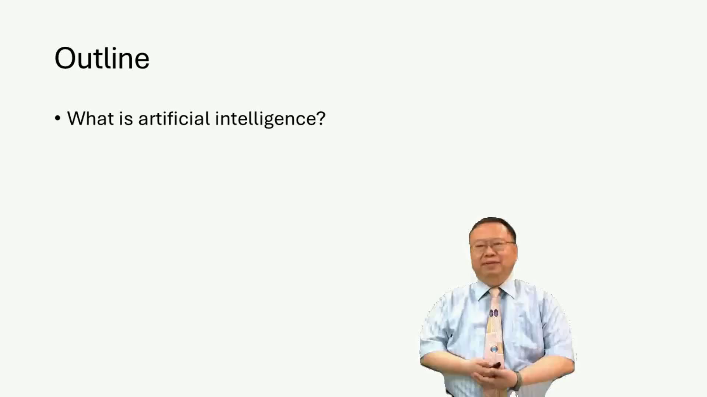





Production of virtual humans
Task2:MOCS video batch courses
https://github.com/1846659840/AutoMocs
Input
Bert-Vist2
Linly_Talker frame

Slide 2
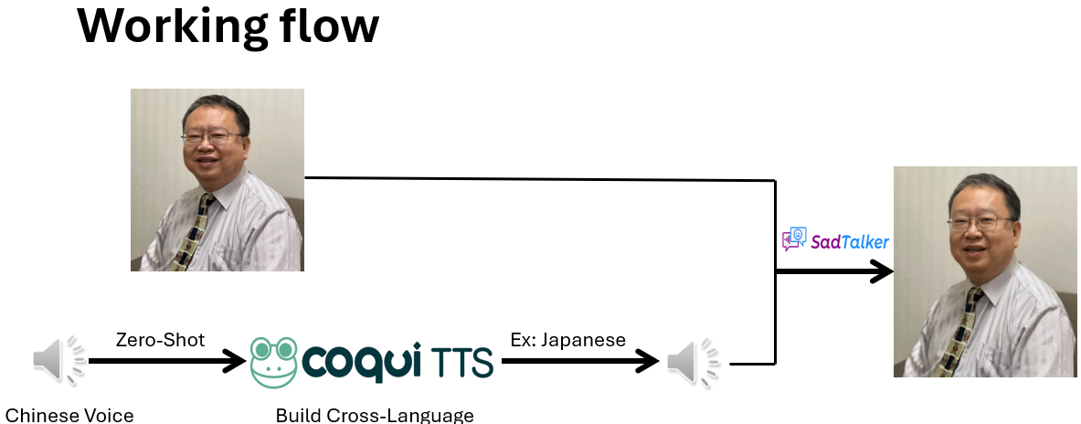
Related Work
In Task1: We use XXTS and Sadtaker to make a digital human video.
But the voice and video sometimes not real .
1.The Zero shot do generate Voice is not a good way .

Slide 3
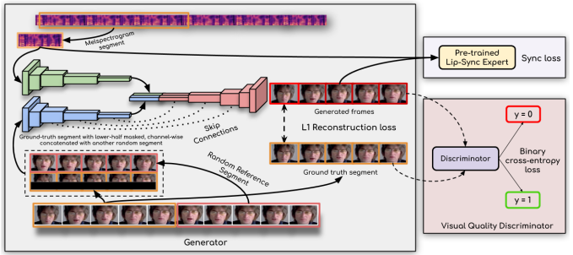
Working flow
Bert-Vist2
Wav2Lip

